Slide 1

A PoolParty Analysis
Austrian Newspaper Coverage of Politics
Thomas Dornigg, Clemens Kaiser, Gregor Knoll

Slide 2
Our partners
Victor Mireles-Chaves
Dr. Axel Polleres

Slide 3
Our project
Newspapers
Does the sentiment between them differ?
Parties
What parties are reported on the most?
How are they reported on?
Politicians
Who is reported on the most positively/negatively?
Who polarizes the most?
Do their journalists‘ tweets reflect the articles' sentiment?

Slide 4






What is our data?
Tweets
Tweepy API
RSS
Cron job
Leading Journalists
Runs every 2 hours
Collection Period: Nov 2nd 2018 – Jan 15th 2019

Slide 5
What does a Twitter Feed look like?
User Name/ID: unique identification of each user
Time Stamp: time when the tweet was sent
Tweet Text: the body of the tweet (max. 140 characters)
Links: links can be embedded within a tweet. Links are a way that users share information (e.g. external link to newspaper-article)
Retweets: a retweet is when someone shares a tweet with their followers.
Favourites/Likes: you can “like” a tweet to keep a history of content that you like in your account
Source: from what platform/app the tweet was posted

Slide 6
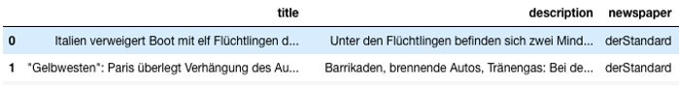
What are RSS-feeds?
Rich Site Summary
Used to publish frequently updated information
Summary of articles
Can contain links and images

Slide 7
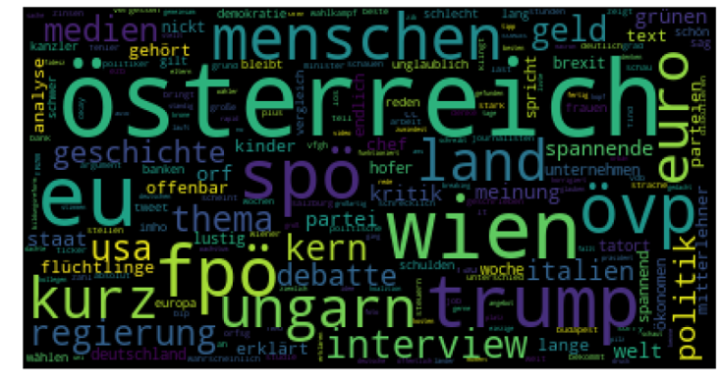
Twitter-feeds

Slide 8
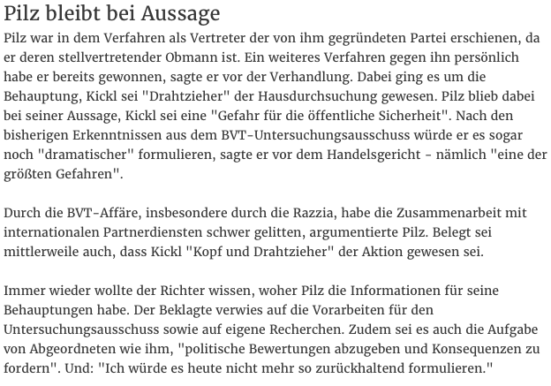
A brief Introduction to Sentiment Analysis
the field of study that analyzes people’s opinions, sentiments, appraisals, attitudes, and emotions toward entities and their attributes expressed in written text

Slide 9
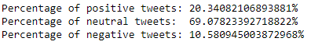
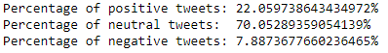
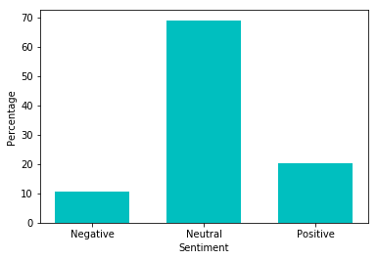
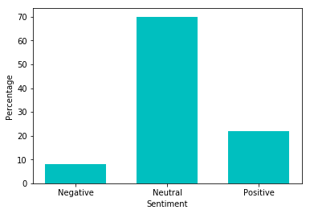
Twitter-feeds Sentiment Analysis
Der Standard
Kronen Zeitung

Slide 10
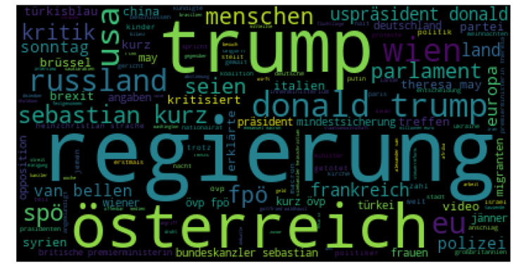
RSS-feeds

Slide 11
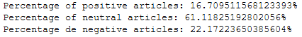
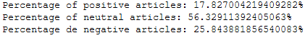
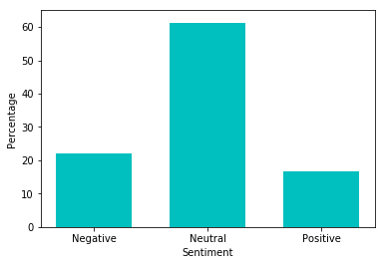
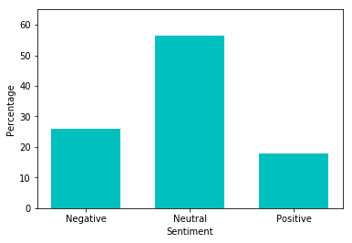
RSS-feeds Sentiment Analysis (1)
Der Standard
Die Presse

Slide 12
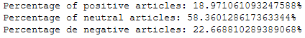
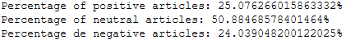
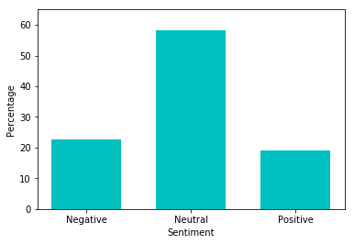
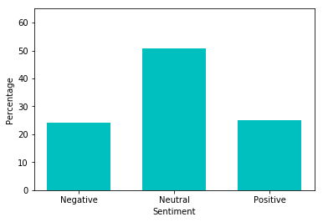
RSS-feeds Sentiment Analysis (2)
Kleine Zeitung
Salzburger Nachrichten

Slide 13
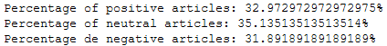
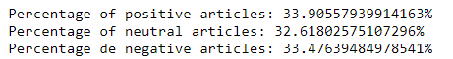
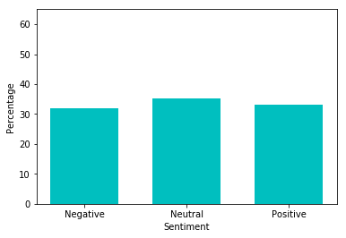
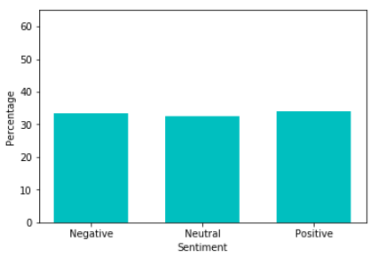
RSS-feeds Sentiment Analysis (3)
Kronen Zeitung
Heute

Slide 14

Let‘s have a pool party!
helps organizations build and manage Enterprise Knowledge Graphs
Released in 2009
Platform based on semantic technologies and machine learning
*no pool required
Notes:
test_wu / wKnnONZ6vI28
https://datascience.poolparty.biz/PoolParty/!/auth/login

Slide 15
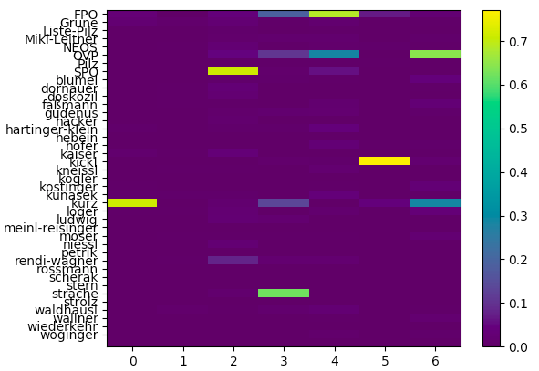
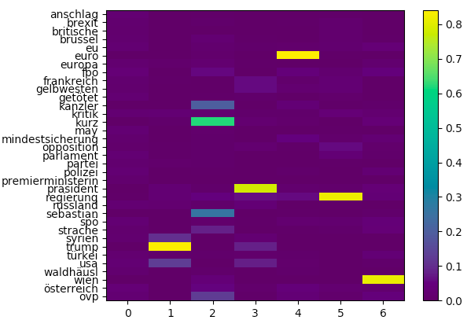
K-Means – A quick comparison
PoolParty Vectorizer
TF-IDF Vectorizer

Slide 16
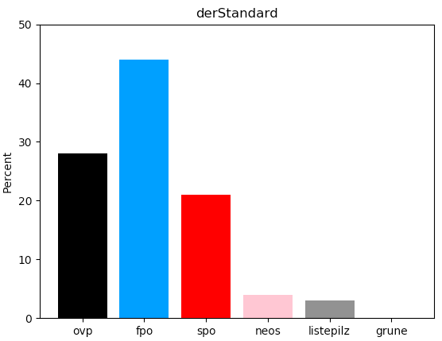
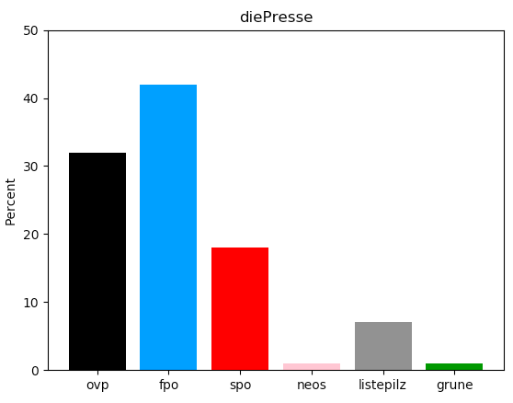
While Standard and Presse report more on FPÖ...

Slide 17
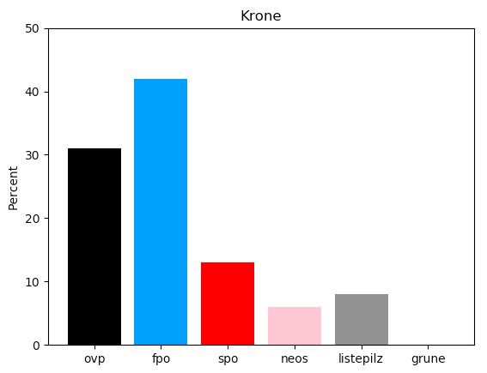
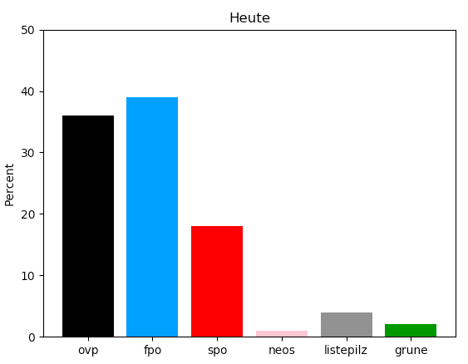
… even more so than Krone and Heute ...

Slide 18
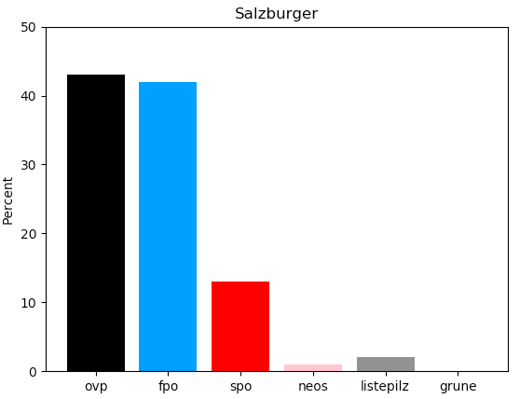
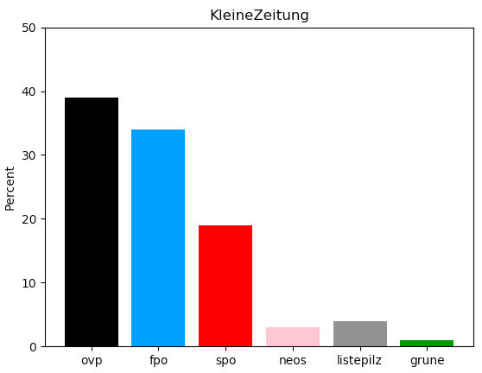
... SN and Kleine Zeitung talk more about ÖVP.

Slide 19
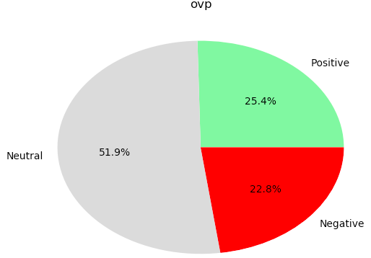
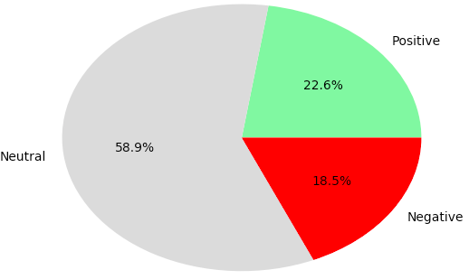
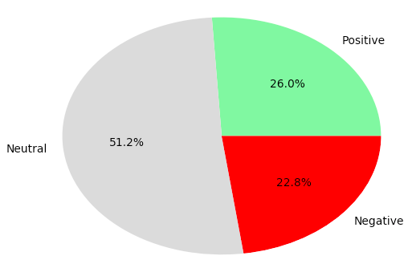
The reporting hardly differs between the 3 big parties.
Positive
Neutral
Negative

Slide 20
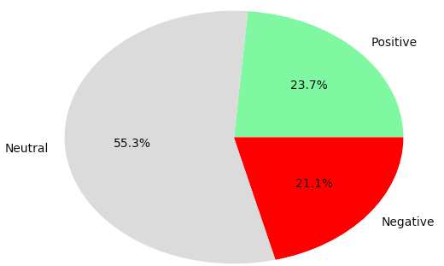
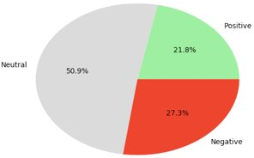
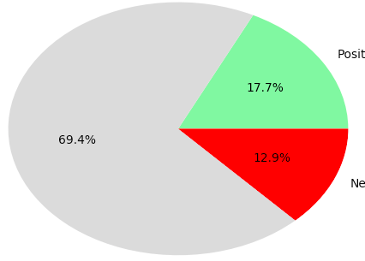
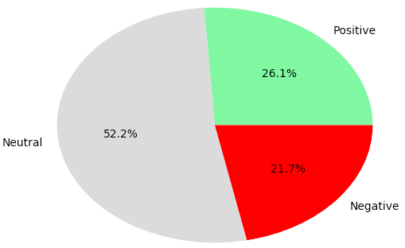
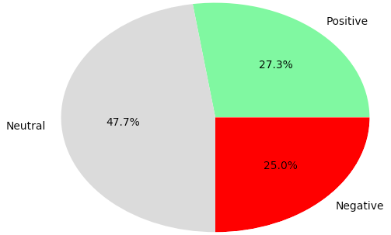
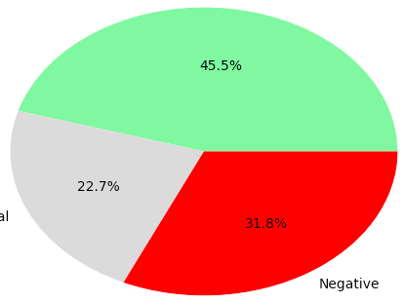
How do the newspapers report on ÖVP?

Slide 21
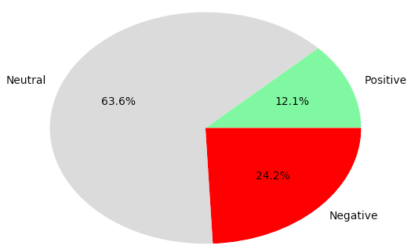
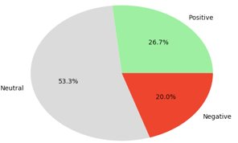
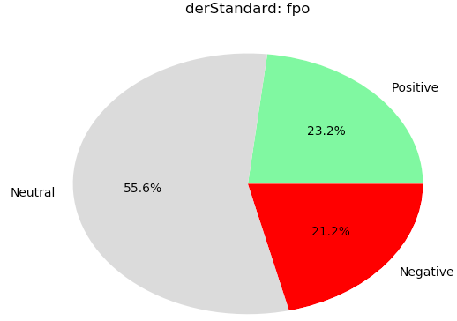
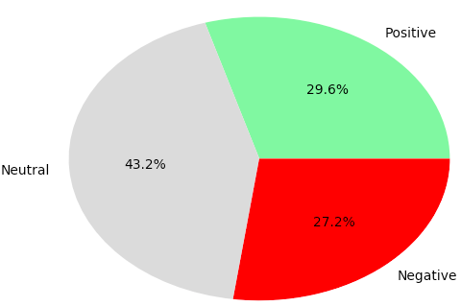
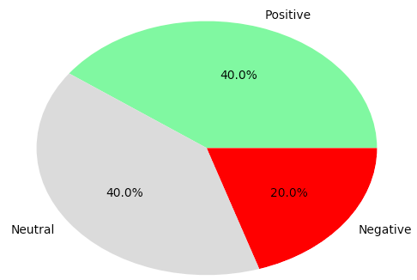
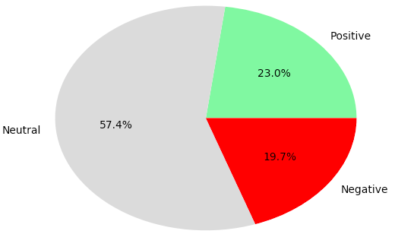
How do the newspapers report on FPÖ?

Slide 22


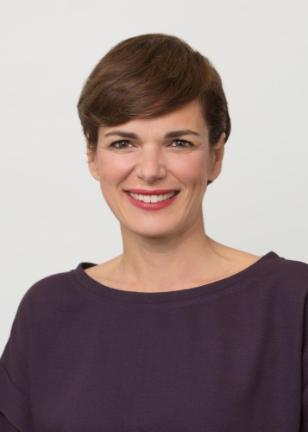
Who is reported on the most positively?
Niessl
(SPÖ)
38.9% positive
Hartinger-Klein
(FPÖ)
36.0% positive
Rendi-Wagner
(SPÖ)
33.3% positive

Slide 23

Who is reported on the most negatively?
Löger
(ÖVP)
39.5% negative
Pilz
(Jetzt)
36.4% negative
Kneissl
(FPÖ)
31.8% negative

Slide 24

Who polarizes the most?
Mikl-Leitner
(ÖVP)
32.2% positive
31.8% negative
Hartinger-Klein
(FPÖ)
36.0% positive
24.0% negative
Ludwig
(SPÖ)
21.4% positive
35.7% negative

Slide 25
What does it all mean?
The sentiment of journalists‘ tweets is not linked to the sentiment of the corresponding newspapers‘ articles.
The articles’ sentiment partly differs from newspaper to newspaper.
3
There is a noticeable difference in the sentiment of articles depending on the politician they are about.
1
2

Slide 26
Some issues and limitations
Finding the right ideas to explore
Working with German text data
3
RSS feeds as well as Tweets provide little text to analyse
4
Collecting data over a longer period of time
1
2

Slide 27
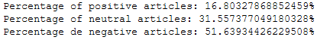
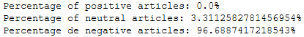
What else did we notice in our data?
Articles including the term “police“ receive a very negative sentiment
Most likely because they are often connected to terms like 'verletzt' or 'tot‘, which indicate negative sentiment

Slide 28
What could be done in the future?
Get full articles to analyze
Perform more fine-grained sentiment analysis
Perform Time-lapse analysis
Data
Detail
Concepts
Time
Include more concepts to analyse
Notes:
Fine grained sentiment:
https://www.quora.com/What-does-fine-grained-sentiment-analysis-mean
https://www.iaria.org/conferences2016/filesHUSO16/OrpheeDeClercq_Keynote_ABSA.pdf
Time-lapsed Analysis:
Wie und wieviel wurde über einen bestimmten Zeitabschnitt über einzelne Parteien/Politiker berichtet? (e.g. jetzt sehr häufig über Regierung bzw. Waldhäusel, … )
Correlation of Sentiment:
Über bestimmte Topics wird neg/pos. berichtet – e.g. Polizei --- > future work: wird über diese per se pos/neg berichtet oder stehen sie nur im Zusammenhang mit pos/neg Berichterstattung?

Slide 29

Thomas Dornigg - 1551056
Clemens Kaiser - 1550038
Gregor Knoll - 1454269

Slide 30
Appendix

Slide 31
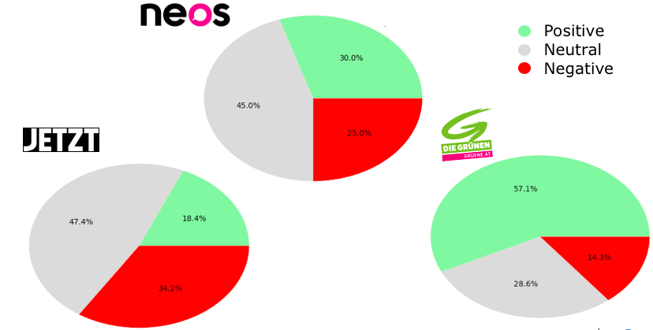
Reporting on the 3 smaller Parties

Slide 32
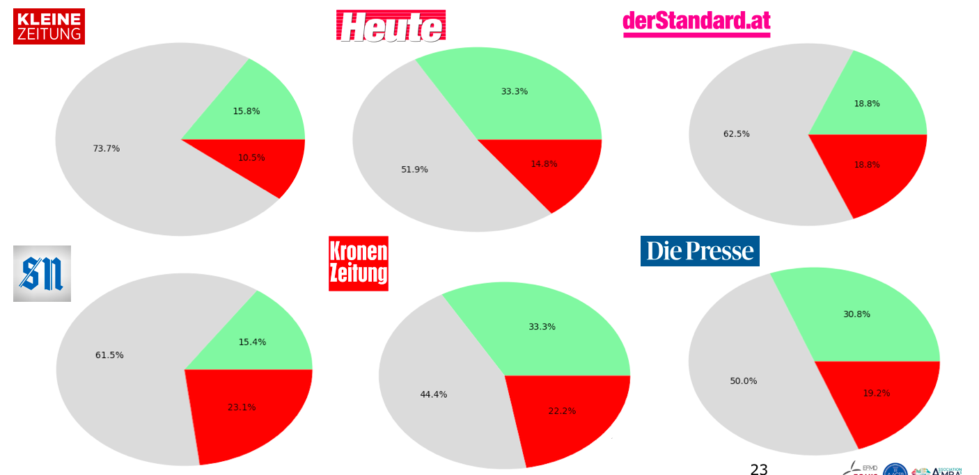
Reporting on the SPÖ

